Slide 1
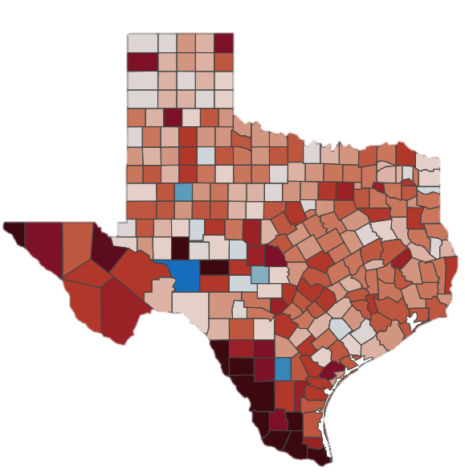
Ranking Resilience Attributes for Texas Public School Districts
Honors Thesis
Daniel Payan

Slide 2
Overview
Research Topic/Purpose
Data Sources
Pre-processing & Exploratory Data Analysis
Feature Selection
Machine Learning Pipeline
Most Significant Features
Conclusion & Future Work

Slide 3

Research Topic/Purpose
COVID-19 school closures resulted in heavy learning loss across Texas.
No consensus could be reached on the impact of reopening schools, leading to unbalanced levels of learning loss.
The goal of this research is to demonstrate an applied data science pipeline that can aid policymakers in understanding the features that have had the most influence on learning recovery, so that in the future they are better prepared and equipped to develop effective solutions.

Slide 4
Data Sources
Data Frame | Data Source | Level | RowXCol
Census | Census Bureau 2010 | County | 254, 37
Covid | USAFacts | County | 253, 16
Covid | DSHS | District | 1216, 7
CCD | National Center for Education Statistics | District | 994, 98
LAUS | U.S. Bureau of Labor Statistics | County | 254, 13
STAAR 2019 | Texas Education Agency | District | 1184, 217
STAAR 2021 | Texas Education Agency | District | 1182, 217
STAAR 2022 | Texas Education Agency | District | 1185, 217
ADA | Texas Education Agency | District | 1225, 4
ESSER | Texas Education Agency | District | 1208, 6
The data utilized for this work was gathered from six different sources.
Census Bureau 2010
USAFacts
Texas Department of State Health Services (DSHS)
National Center for Education Statistics
U.S. Bureau of Labor Statistics
Texas Education Agency
The data frames were merged based on school district ID numbers and county FIPS codes into a comprehensive dataset, which contained 1,160 school districts (rows), located in 253 counties, and containing 750 attributes (columns)

Slide 5
Pre-processing
2022 Average Score-2019 Average Score2019 Average Score
Due to the dataset being unlabeled, a target must be created for the machine learning model to work properly.
These labels were made through a four-step process:
Normalize the STAAR scores by grade level (Score value of district / Maximum score for that grade level)
Calculate an average score (Sum the grade level scores / Number of grades)
Calculate a delta between 2019 and 2022
STAAR DELTA = ((2022 Average Score – 2019 Average Score) / 2019 Average Score)
Classify the district based on delta score
Below the 25th percentile : Loss
Within the central 50% : Expected
Above the 75th percentile : Gain

Slide 6


Exploratory Data Analysis
A fully open-source dashboard was developed utilizing Python Panel to aid in the exploratory data analysis of this research.
The dashboard is a group of multiple tabs of information, including:
STAAR Scores for math and reading at both the county and district levels
Student and Staff counts
Funding received by districts from each ESSER program
Normalized differences in STAAR scores by demographic group and grade
These tabs are over a set of three year ranges
2019-2021 (COVID-19 pandemic years)
2021-2022 (Recovery Year)
2019-2022 (Overall Change)

Slide 7
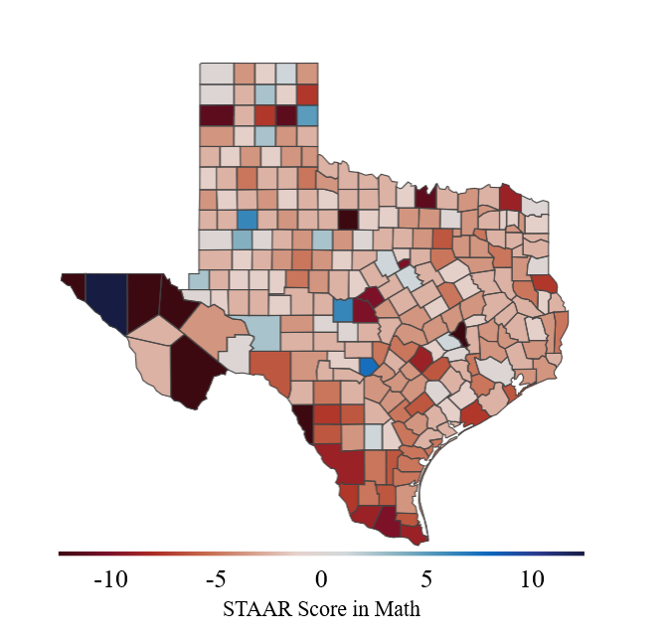
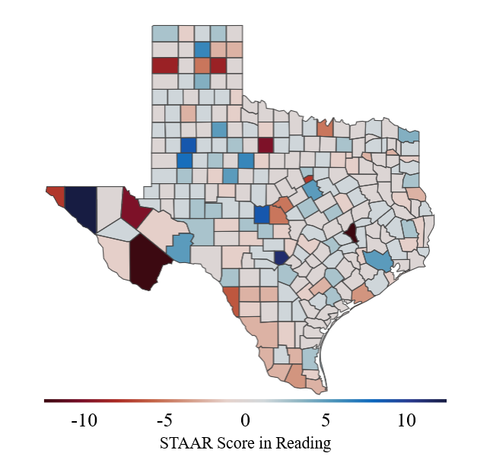
Learning Loss During COVID-19 Years 2019-2021 (Math vs. Reading)

Slide 8
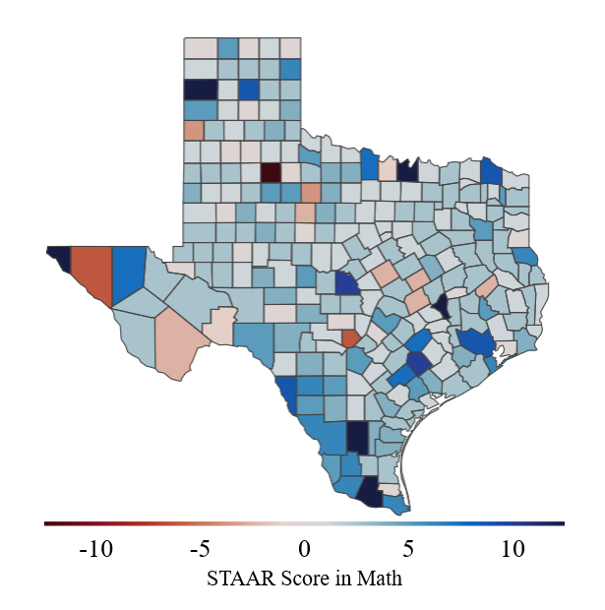
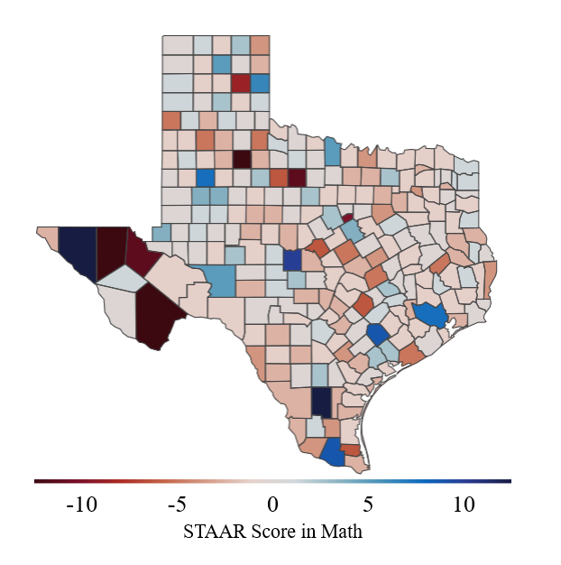
Learning Loss in Math Over Time
2019-2021 (COVID-19 Years)
2021-2022 (Recovery Year)
2019-2022 (Overall Change)

Slide 9
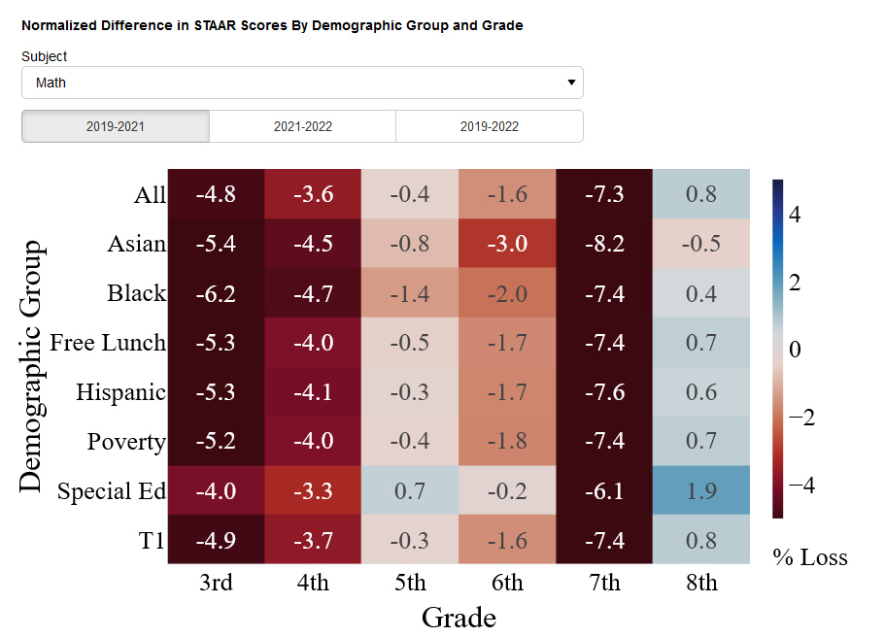
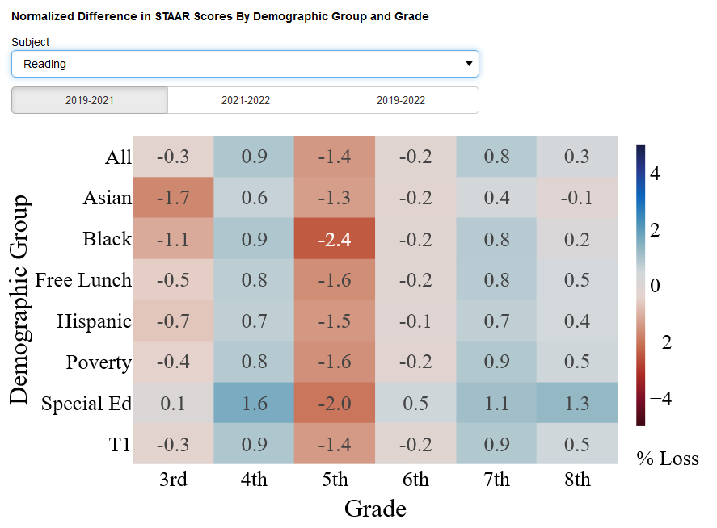
Learning Loss Based on Demographic and Grade

Slide 10
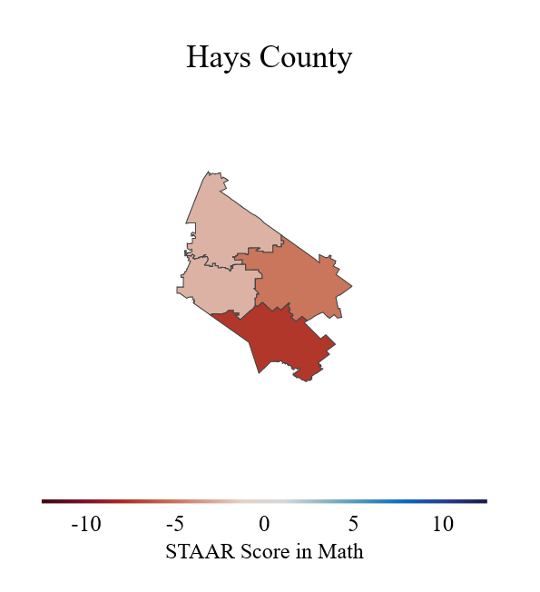
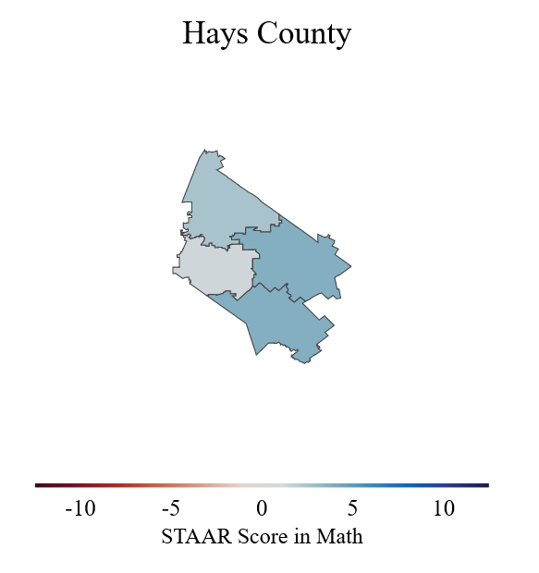
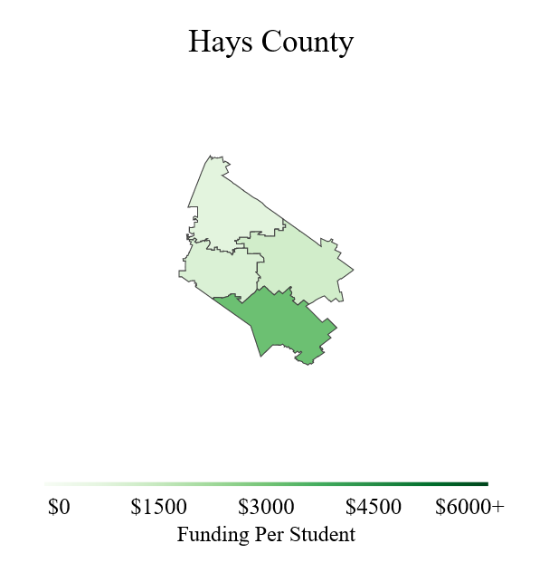
Learning Loss in Hays County vs. Funding
2019-2021 (COVID-19 Years)
2021-2022 (Recovery Year)
Funding Per Student (2019-2022)

Slide 11
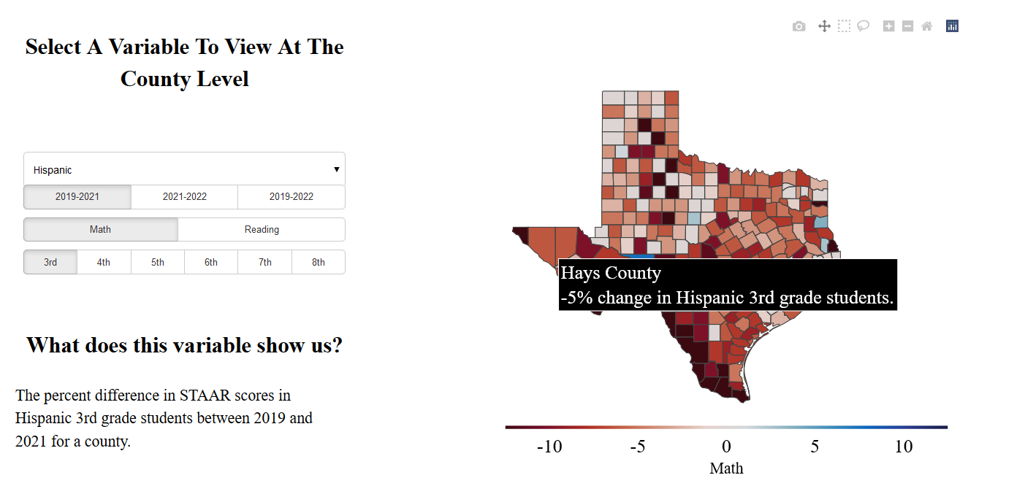
Learning Loss Based on Demographic and Grade at the County Level

Slide 12
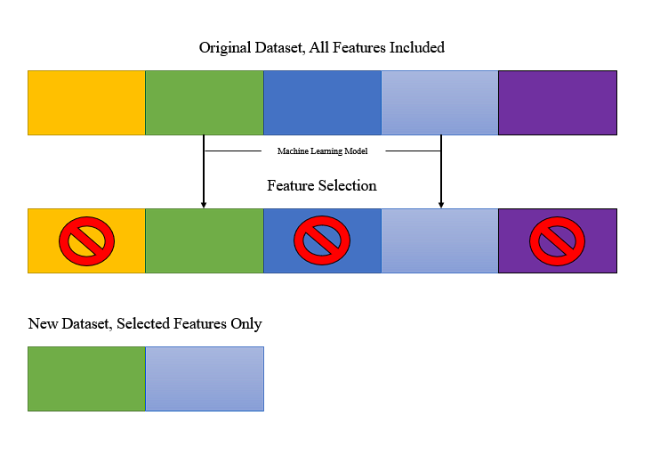
Feature Selection
Feature selection is the process of reducing the number of input variables when developing a predictive model.
It can:
Improve performance of a model
Decrease the level of computational complexity
Allow the user to identify the most influential features on a target value
The Loss, Gain, Expected labels developed earlier will be our target value for feature selection

Slide 13
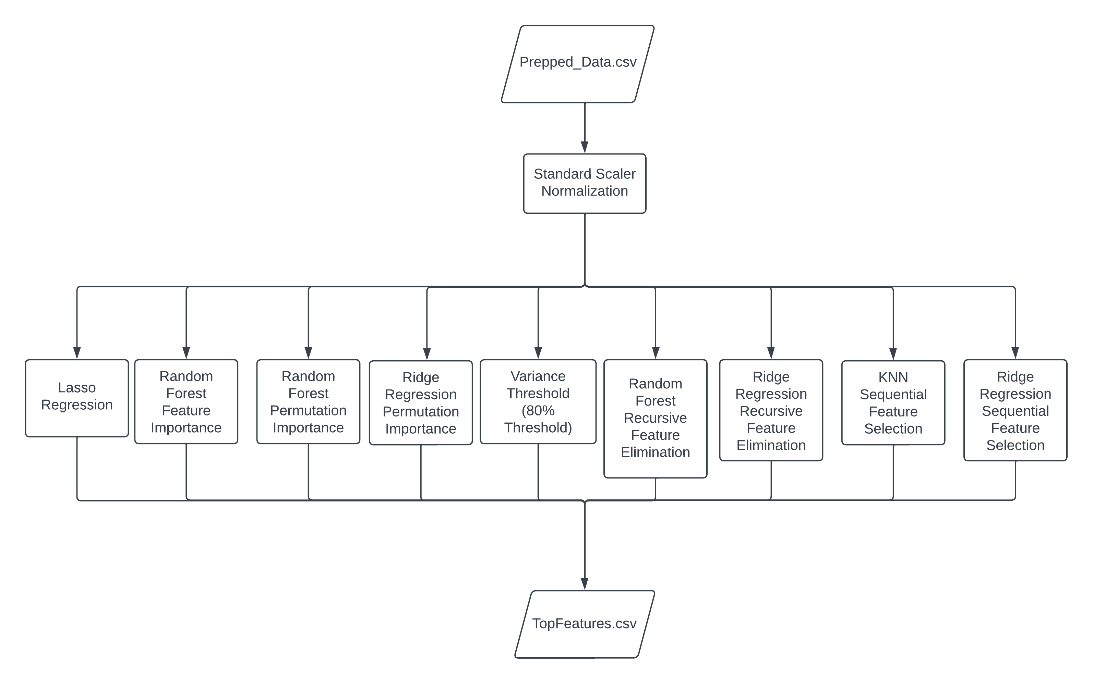
Machine Learning Pipeline
Nine different machine learning methods were used for feature selection:
Lasso Regression
Random Forest Feature Importance
Random Forest Permutation Importance
Ridge Regression Permutation Importance
Variance Threshold (80% threshold)
Random Forest Recursive Feature Elimination
Ridge Regression Recursive Feature Elimination
KNN Sequential Feature Selection
Ridge Regression Sequential Feature Selection
Each of these methods resulted in one of three types of scores
Binary Values
Ranking Scores
Non-zero Importance Scores

Slide 14
Ranking the Most Significant Features
Round Rock Campus
1555 University Blvd.
Round Rock, Texas 78665

Slide 15
Conclusion/Future Work

123.456.7890

boko@txstate.edu
College/Department Name
601 University Drive
San Marcos, Texas 78666


